Slide 1
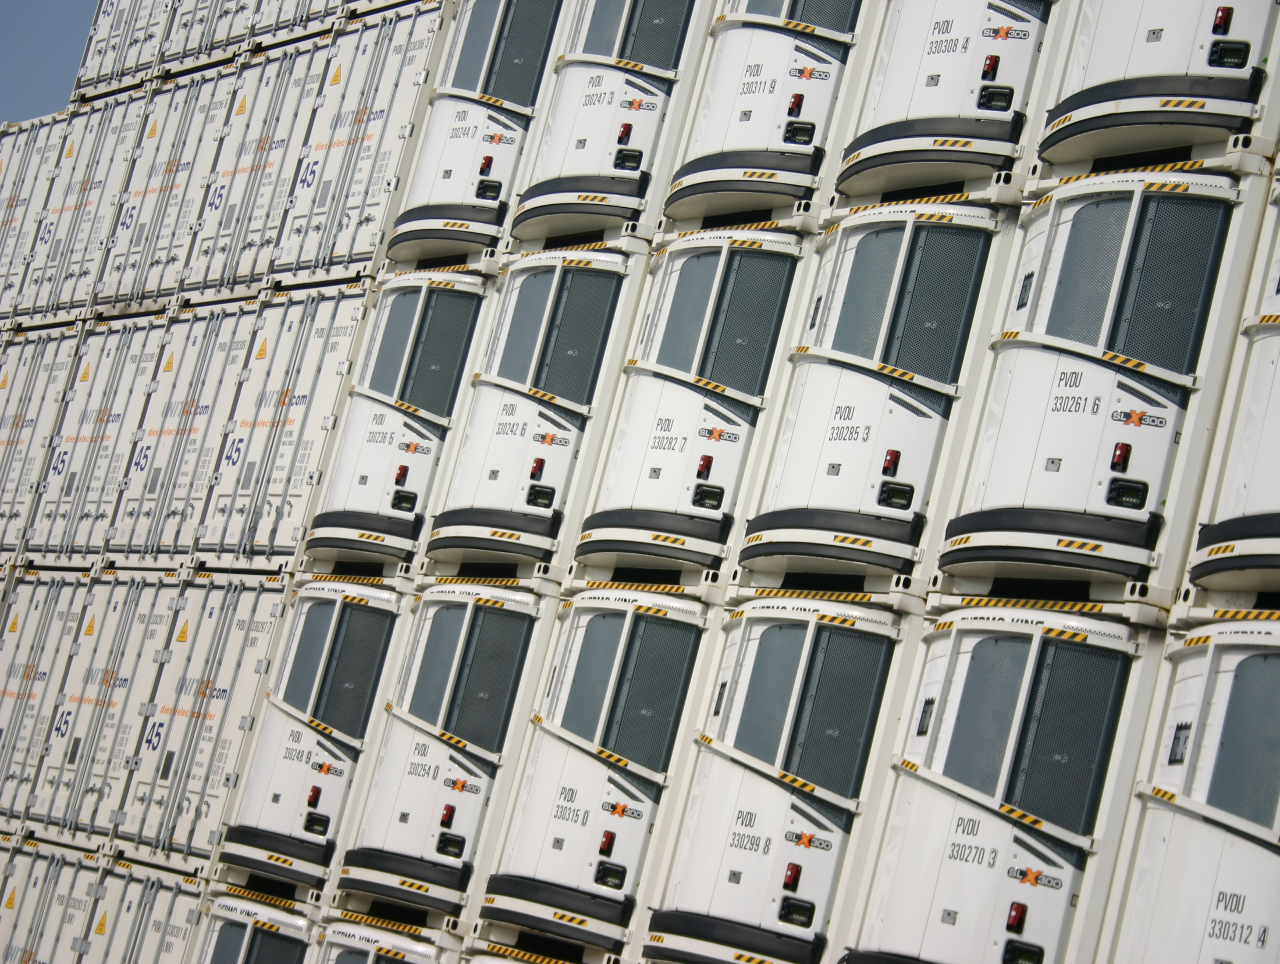
Perishable transport

Slide 2
Agenda
Goal and definition
Legislation
Sustainability
Different concepts within road transport
Used techniques in cooling
Intermodal transport

Slide 3

Perishable transport
Perishable transport is transport of (perishable) goods within a controlled atmosphere to avoid unnecessarily loss of quality of the product.

Slide 4
Perishable transport
Flowers and plants
Vegetables and fruit
Meat
Dairy (zuivel)
Foodproducts (including fish)
Examples:
Milk : cooled
Fish : cooled or frozen
Chocolate heated
Turnover of perishable transport in Holland: 1 bil Euro

Slide 5
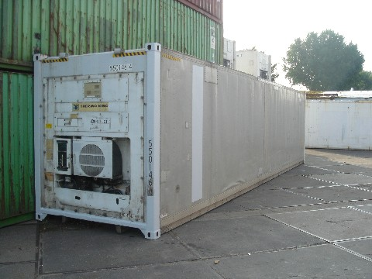
Perishable transport
Cooled
Heated
Ventilated
Furthermore……
….avoiding contamination
….check of the cargo
…..combined cargo/temperature possible

Slide 6
Perishable transport
 | plus | minus
airfreight | high speed | no water allowed
 | low volume / weight | high price
roadtransport | flexible | double crew /limited driving time
 | FTL/LTL | cooling by diesel
 | guarded transport
railtransport | timetable | speed
 |  | unguarded transport
 |  | cooling bydiesel / nu surveillance
barge/shortsea | timetable | speed
 | guarded transport
 | low price cooling by electricity

Slide 7
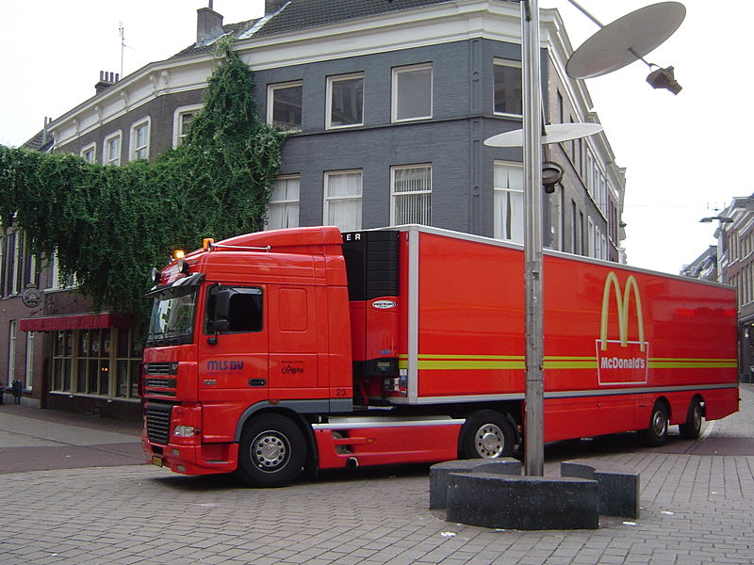
Reefers
Temperature range from -30 until +30
So, it can heaten too !
Walls, floors and ceilings are made of isolated material.
Truck with side curtains: only for cooled products until freezing point.

Slide 8
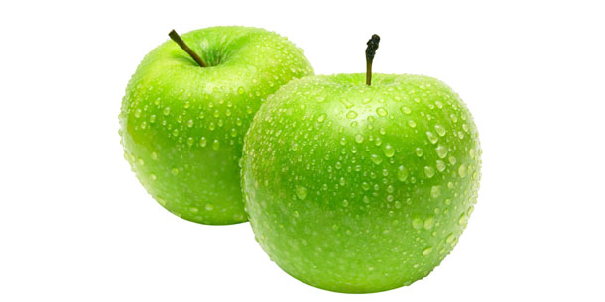
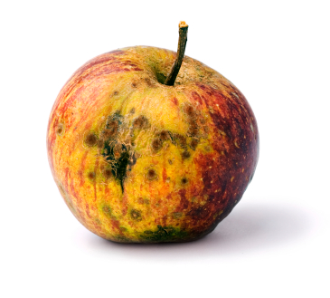
Atmosphere
Modified Atmosphere (MA)
Standard Atmosphere inside packaging
21% oxygen and 0,03% carbon dioxide
Controlled Atmosphere (CA)
Composition as desired
LO (low oxygen about 2%)
ULO (Ultra low oxygen < 2%)
Example:
Apple →
high speed of respiration →
reduce oxygen →
lifetime prolongation

Slide 9
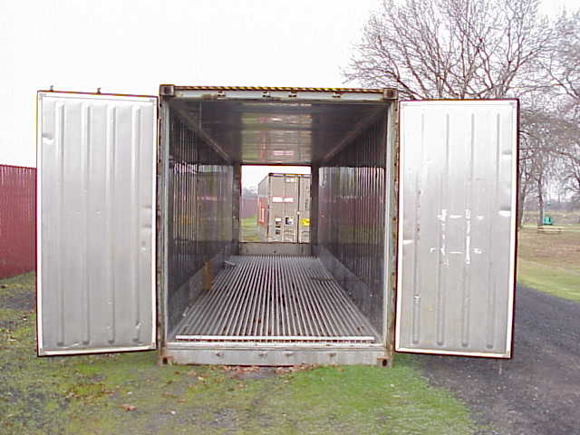
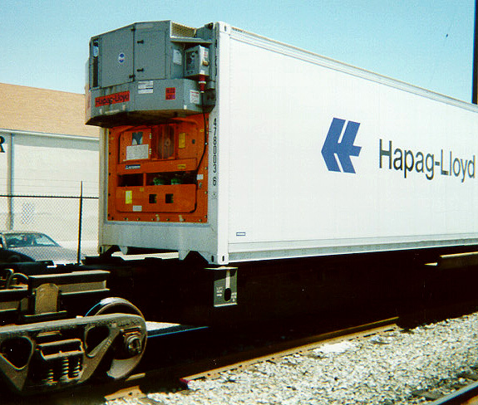
Methods of cooling
With generator (intern)
With generator (extern)
Without generator
Cooling with ice.

Slide 10
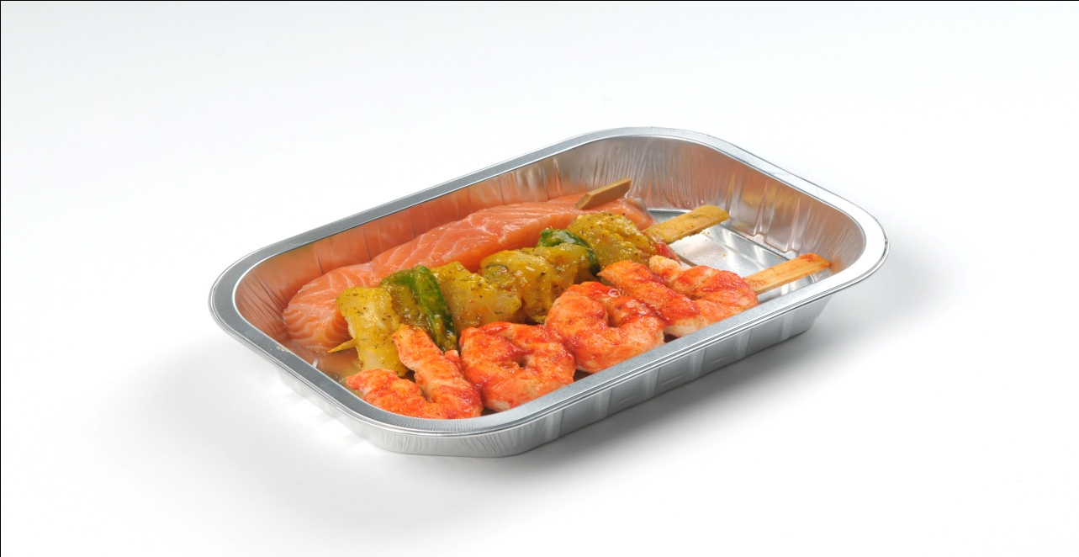
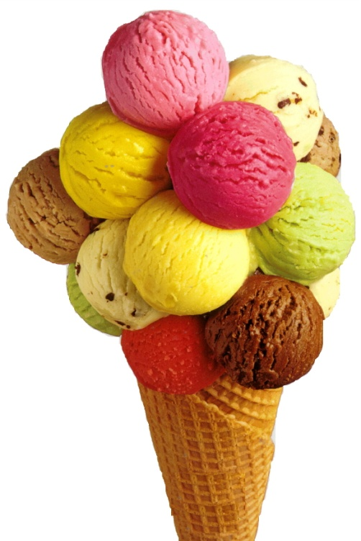
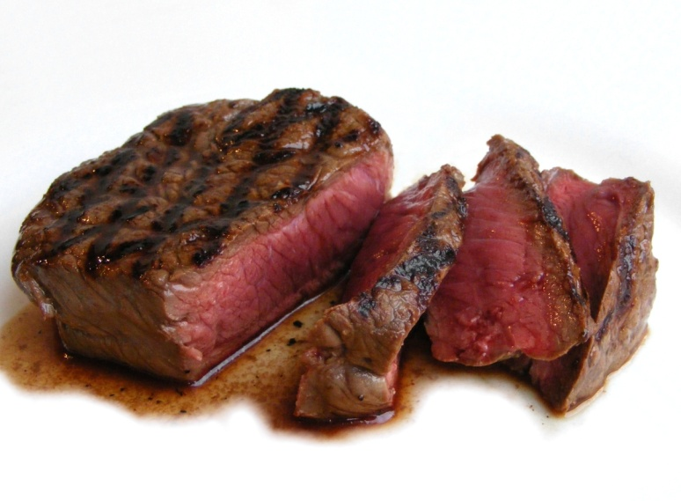
Transport temperatures
Fish: frozen -18⁰
fresh on ice -2⁰
Consumption ice -24⁰
to avoid crystallisation
Meat: fresh + 2⁰
frozen -10⁰

Slide 11

New developments
Airfreight will become less important due to alternatives
Speed can/will be reduced by intensive monitoring
Growth of plants will continue during transport
PPO (Applied plant research dept. situated in Wageningen, Holland) is a leading organisation in these kind of developments

Slide 12

Legislation / rules
Together we have made the following arrangements ……

Slide 13
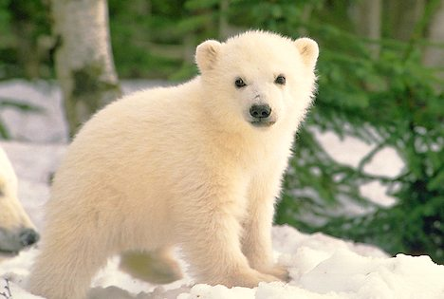
ATP: Accord Transport Perissables
ATP is valid for international transport of deeply frozen, cooled and heated products.
ATP describes frameworks for:
Insulance (isolatiewaarde) of the cargo space
Temperature range of the cooling device.

Slide 14
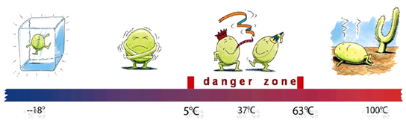
HACCP: Hazard Analysis and Critical Control Points
HACCP is a checking system to secure the constant quality of food and the safety of food. This all for the consumer.
HACCP is valid as from production until consumption including transport and storage.
The system is developed and checked by the market itself.

Slide 15
Essential points of HACCP
The 7 essential points of the HACCP – system are:
Inventory all potential dangers:
Determine the Critical Control Points (points within the process where risks can be prevented or limited);
Determine the critical limits per CCP and determine how they can be guarded or monitored.
Determine the corrective actions what will lead to return to safety;
Use verification as a periodical check to see if HACCP still works properly.
Document and record everything you have adapted and how.

Slide 16
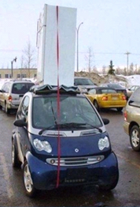
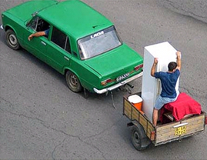
Perishable transport: assets
With cars who have an isolated loading space and a cooling device

Slide 17
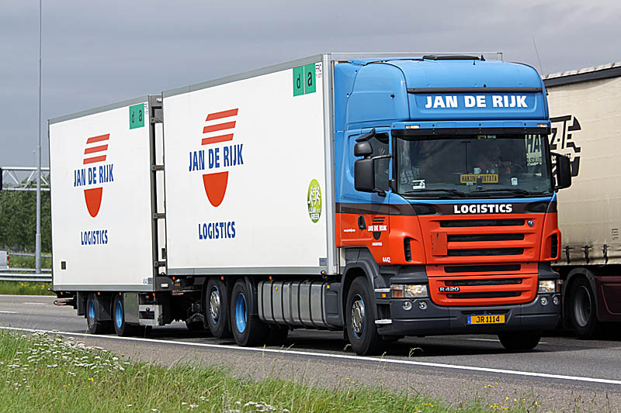
Perishable transport: various assets/concepts

Slide 18
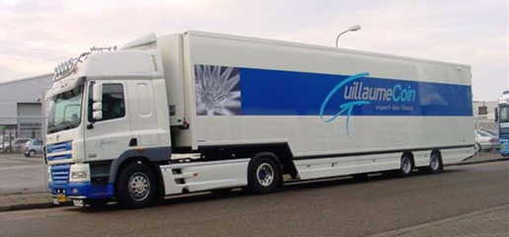
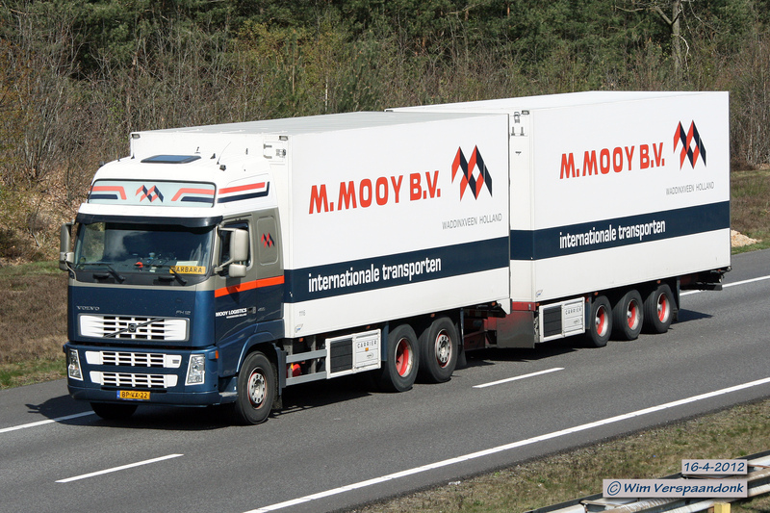
International: truck + semi-trailer

Slide 19
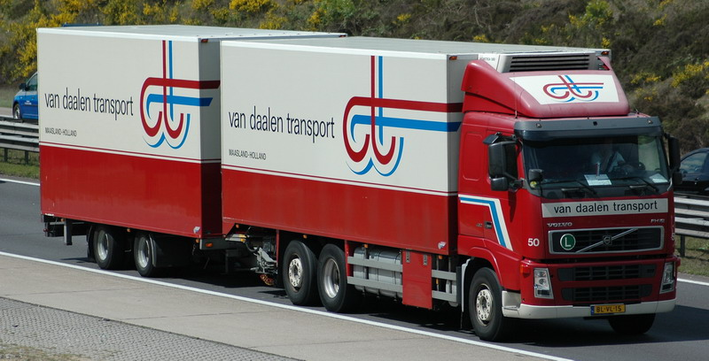
International: truck + trailer

Slide 20
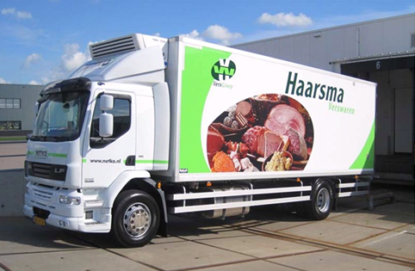
National: truck + trailer

Slide 21
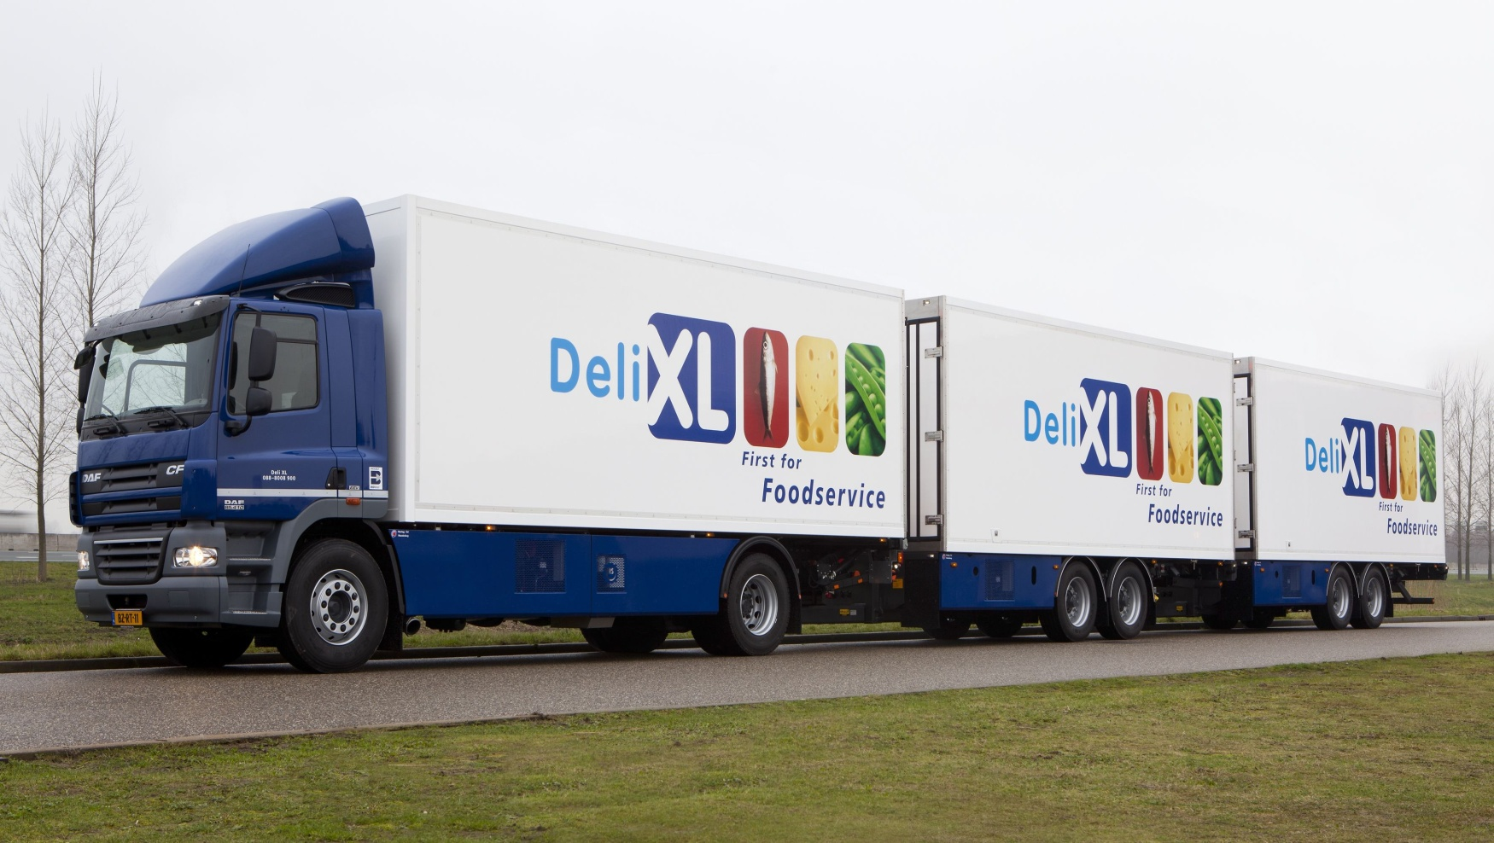
National: LHV

Slide 22
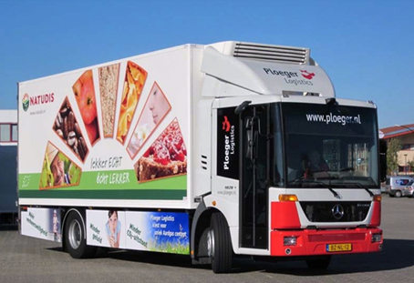
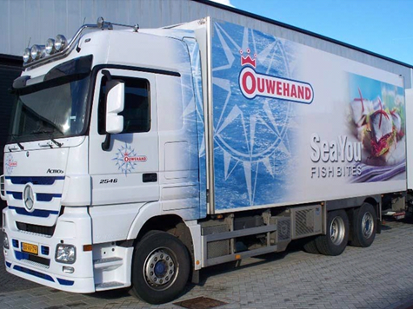
Distribution: Trailer

Slide 23
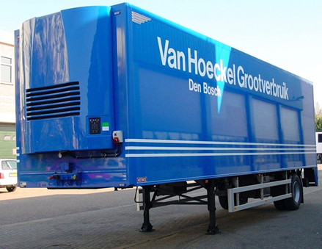
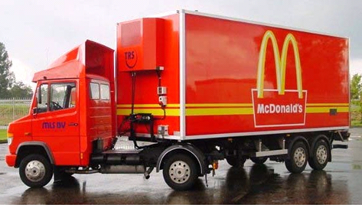
Distribution: city semi-trailer

Slide 24
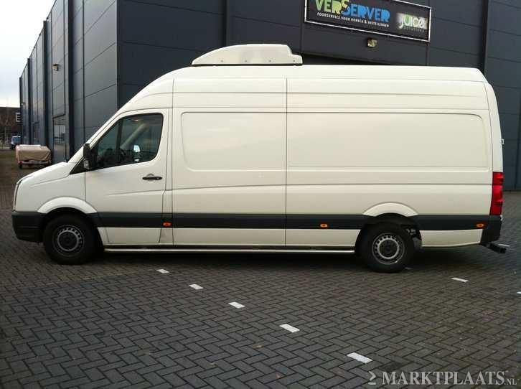
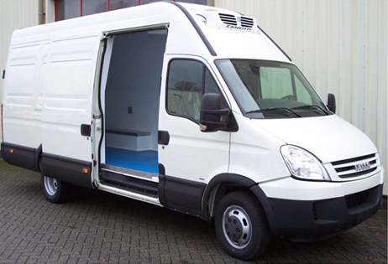
Distribution: delivery van

Slide 25
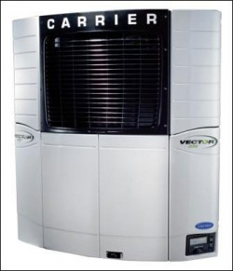
The sustainable refrigerator
The sustainable refrigerator……
……………. makes a minimum of noise (with full power)
…………….uses a minimum of power or fuel
…………….has a minimum of maintenance
…………….emits a minimum of emission
……………. is as light as possible.

Slide 26
Drive concepts of the cooling device
Direct driven
Cooling by C0₂ or nitrogen (stikstof)
Diesel-compressor driven
Diesel-generator driven
truck-generator driven
Hydraulic-electric driven
Truck engine
compressor
Heat exchanger
Truck engine
Direct injection
Truck engine
Diesel engine
compressor
Heat exchange
Truck engine
Diesel engine
Generator
compressor
Heat exchange
Truck engine
Generator
compressor
Heat exchange
Truck engine
hydraulic
Generator
compressor
Heat exchange
Not in the concept
In the concept

Slide 27
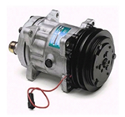
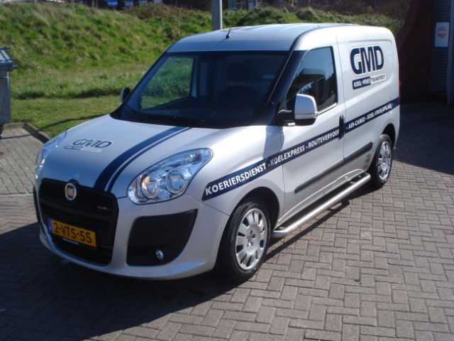
Direct driven
Truck engine
compressor
Heat exchanger
Only for small vehicles like vans.
Compressor is directly fixed to the engine of the van.
Advantages:
cheap
light
simple and reliable
minimum of maintenance
low cost of ownership
Disadvantages
limited power available
with a stationary engine the efficiency is minimum
average performance by constant fluctuating number of revolutions
of the engine.

Slide 28
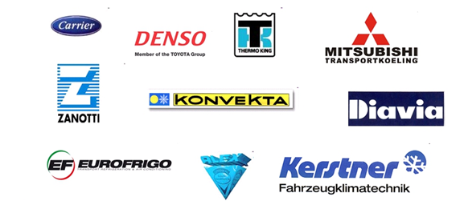
Suppliers of direct driven compressors

Slide 29

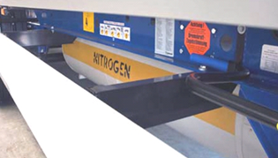
CO₂ or nitrogen (stikstof) drive/cooling cryogenics: is the study of the production and use of very low temperatures
Direct injection
A fluid gas will be insulated in the cargo space or heat exchanger. Due to evaporation the temperature will decrease.
Advantages:
very low noise emission
long lifespan
little maintenance
due to sustainability it is one of the best solutions
Disadvantages:
high cost of ownership
variable cost depends on the current price of gasses
just a few tank stations (in Holland 3-4)
storage tank is heavy and takes a lot of space
dangerous. CO₂ is a toxic and heavy gas.

Slide 30

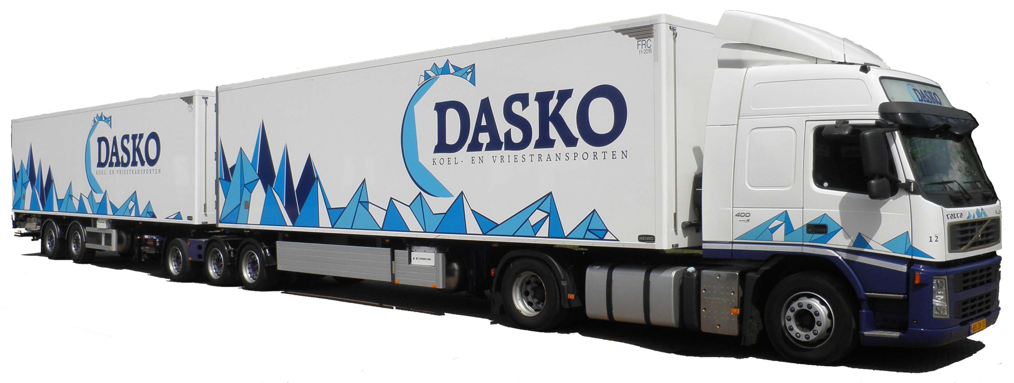

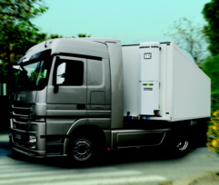
Suppliers of nitrogen cooling
Thermo King is the only
supplier and also supplier for Dasko.
Cryo tech-unit

Slide 31
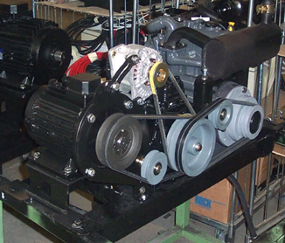
Diesel -compressor driven
Diesel engine
compressor
Heat exchange
The diesel engine drives the compressor,
normally by using belts or V-belts.
Advantages (of diesel driven)
Cooling device works independent
from the truck
reliable technique
relative low purchase price
Disadvantages (of diesel driven)
industrial diesel engines emit 10-60x more pollution than truck engines
higher use of fuel than truck engines
higher noise pollution than truck engines
engines are heavy and big
demand a lot of maintenance

Slide 32
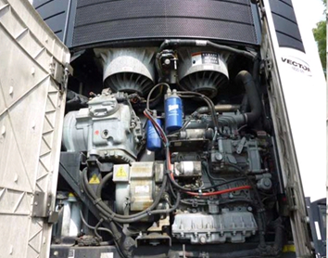
Diesel - generator driven
Diesel engine
Generator
compressor
Heat exchange
The diesel engine is connected to the generator.
The generator delivers power
The power is used for the electric compressor.

Slide 33
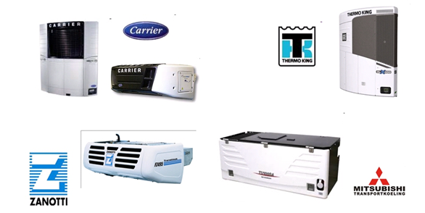
Suppliers of diesel driven systems

Slide 34
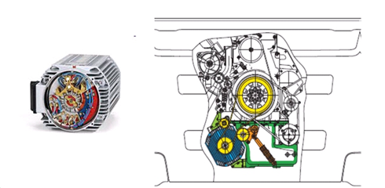
Diesel-generator driven
Truck engine
Generator
compressor
Heat exchange
The generator is connected to the truck engine and delivers power for
the refrigerator.
Advantages:
low use of fuel
low noise pollution
low cost of ownership
Disadvantages:
cooling power dependable of the number of revolutions of the engine
often the only way to connect both devices is by V-belt
generator can have problems with its temperature (lack of air flow)

Slide 35
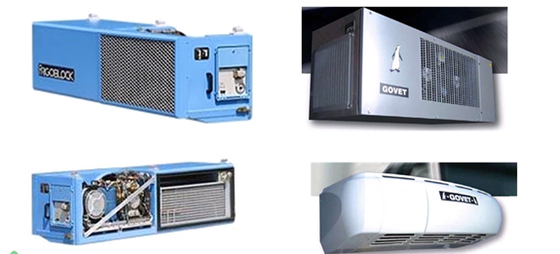
Suppliers of direct driven generators

Slide 36
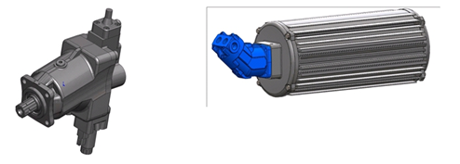
Hydraulic- electric driven
Truck engine
hydraulic
Generator
compressor
Heat exchange
The engine of the truck is connected to a hydraulic system.
The hydraulic systems is connected to the generator
The generator supplies power for the refrigerator.
Advantage:
low use of fuel
power undependable of the number of revolutions of the truck engine
low noise pollution
communication via motor management of the truck possible
Disadvantage:
high purchase costs
Hydro pump hydraulic generator

Slide 37
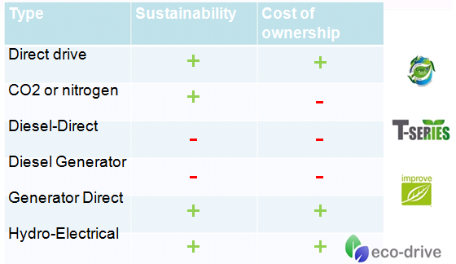
Trade off: price versus sustainability

Slide 38
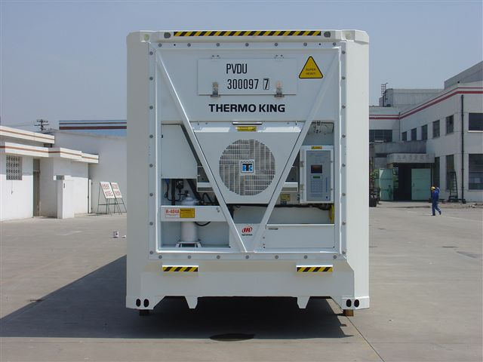
Future ?
The refrigerators will be driven by:
fuel cell
LNG / CNG / Biogas
engine of the truck
braking energy of the truck replenished with solar energy.
The use of the truck engine will remain one of the best alternatives due to the latest emission directives, hybrid solutions, CNG, LNG and Biogas

Slide 39
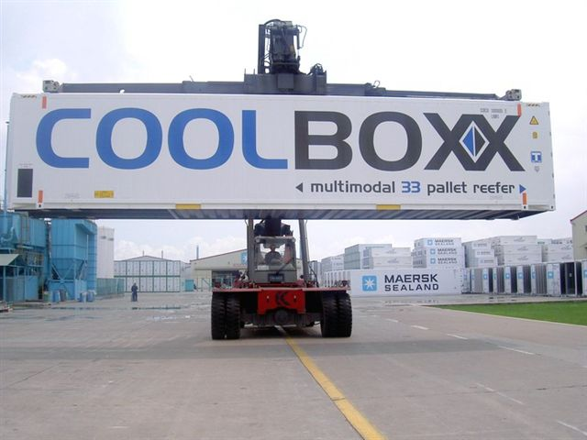
Intermodaal

Slide 40
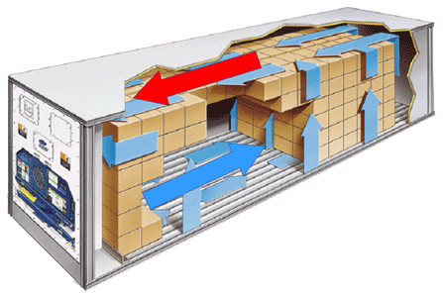
Airflow in a reefer container

Slide 41
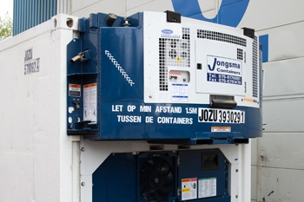
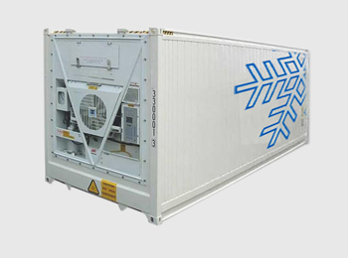
Refrigerate units
Clip-on built-in

Slide 42
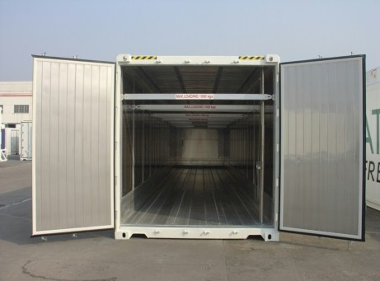
45ft PW HC reefer
Double stack
Internal measurement 13,275 mtr suitable for 33 euro pallets
(45ft container = 13.60 meter trailer)
Double stack system possible
Perfect for rail and barge
Temperature can be controlled and changed on distance via micro processor

Slide 43
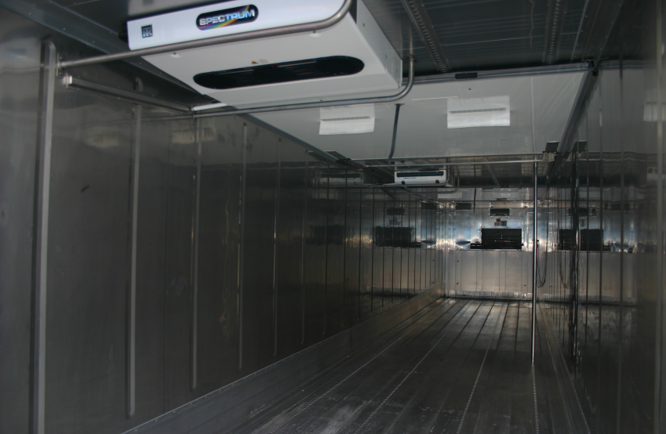
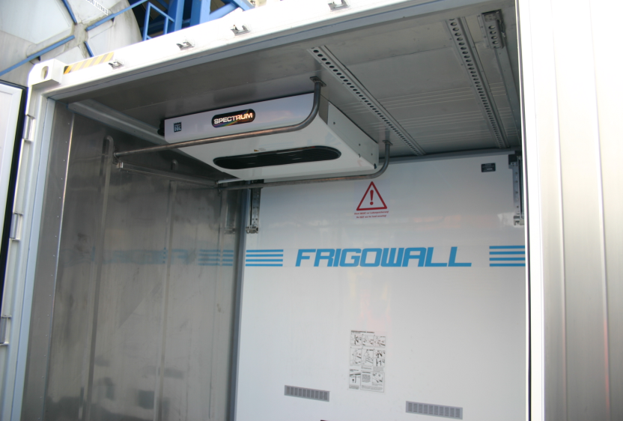
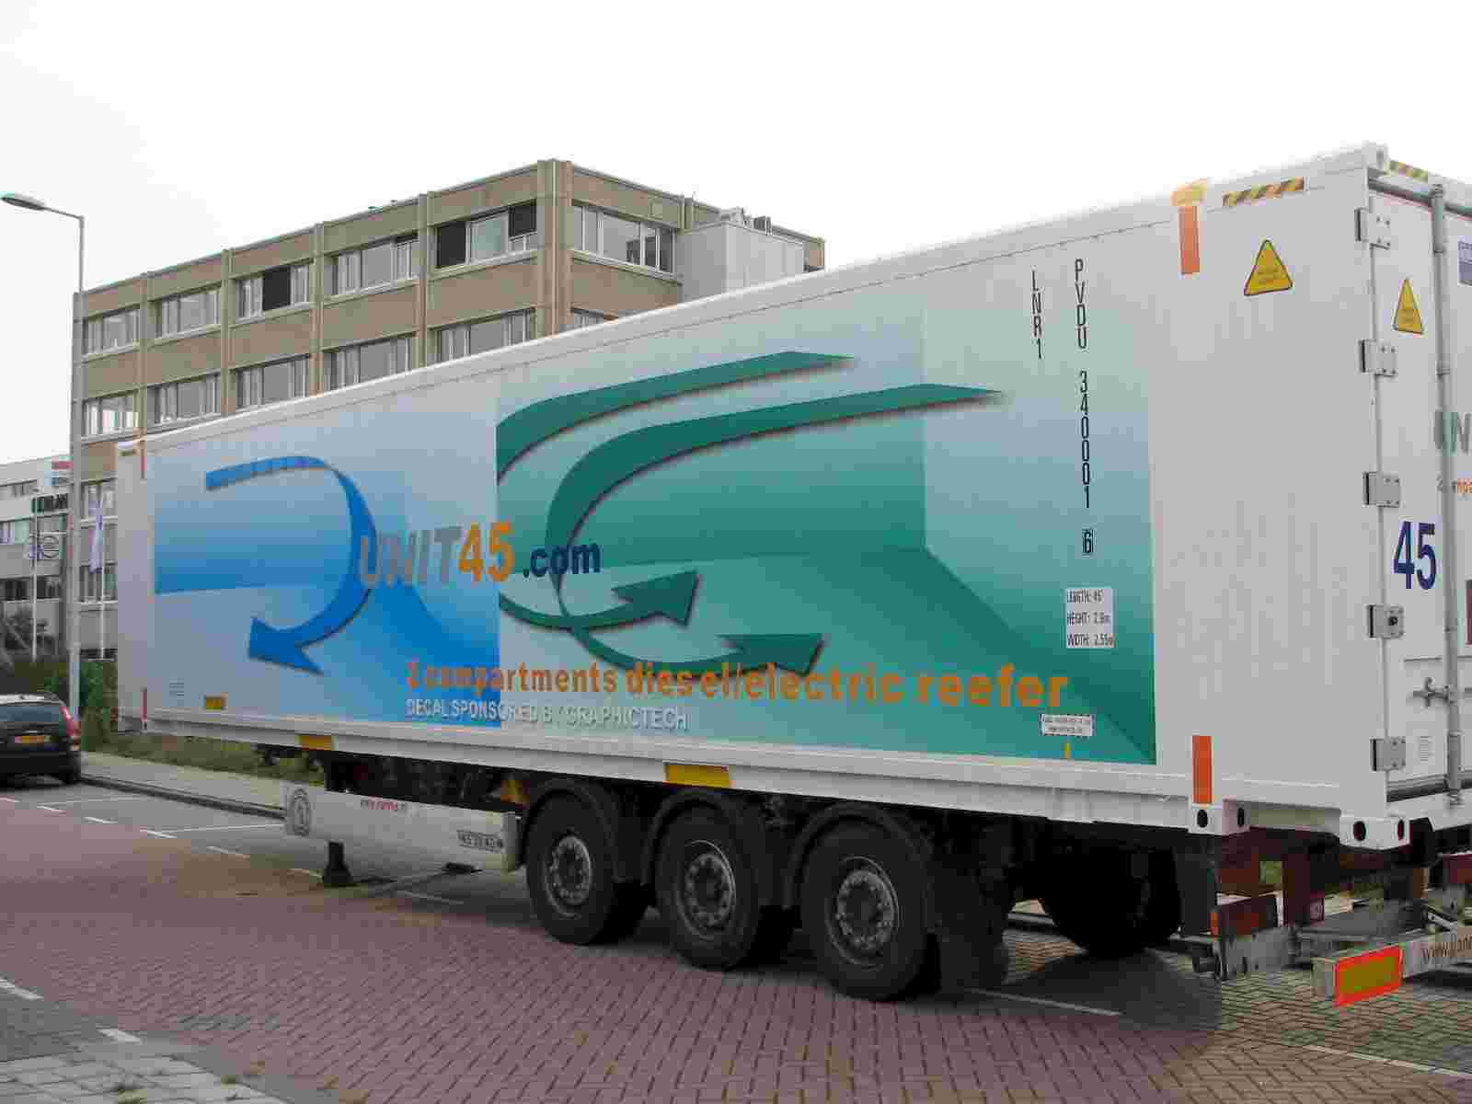
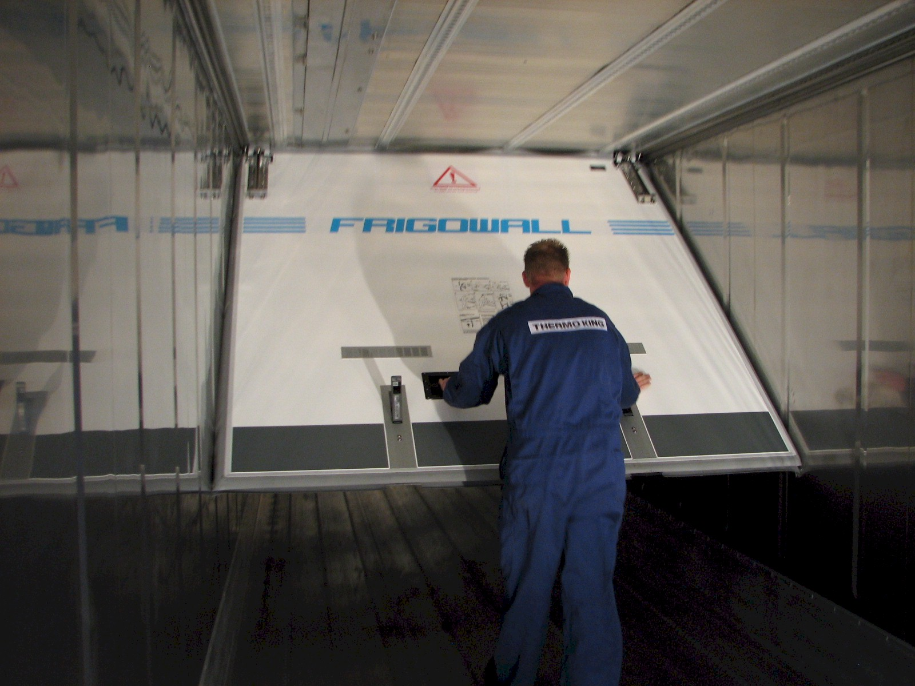
45 ft PW HC dual/triple compartment reefer
with variable temperature zone

Slide 44

Is this tank container suitable for perishable goods?
This is a container for dangerous goods, so……

